Slide 1
DAA
Lecture 4-5

Slide 2
Selection Sort
Summary of Steps
Find the smallest element in the array
Exchange it with the element in the first position
Find the second smallest element and exchange it with the element in the second position
Continue until the array is sorted

Slide 3
Selection Sort
The algorithm works as follows:
Find the minimum value in the list
Swap it with the value in the first position
Repeat the steps above for the remainder of the list (starting at the second position and advancing each time)

Slide 4
Example
Step 1
8
4
6
9
2
3
1
1
2
3
4
9
6
8
Step 2
1
4
6
9
2
3
8
1
2
3
4
6
9
8
Step 3
Step 7
1
2
6
9
4
3
8
1
2
3
4
6
8
9
Sorted Array
1
2
3
9
4
6
8
1
2
3
4
6
8
9

Slide 5
Selection Sort
Alg.: SELECTION-SORT(A)
n ← length[A]
for j ← 1 to n - 1
smallest ← j
for i ← j + 1 to n
if A[i] < A[smallest]
then smallest ← i
exchange A[j] ↔ A[smallest]

Slide 6
Example
Dry Run the Selection-Sort algorithm on the following example
7, -5, 2, 16, 4

Slide 7
Selection Sort
Worst case
О(n²)
Best case
О(n²)
Average case
О(n²)

Slide 8
Insertion Sort
Idea: like sorting a hand of playing cards
Start with an empty left hand and the cards facing down on the table.
Remove one card at a time from the table, and insert it into the correct position in the left hand
compare it with each of the cards already in the hand, from right to left
The cards held in the left hand are sorted
these cards were originally the top cards of the pile on the table

Slide 9
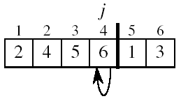
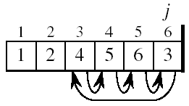
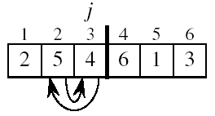
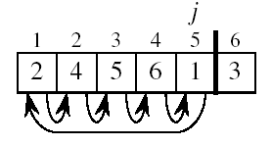
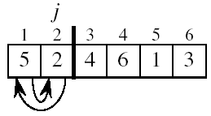

Example

Slide 10
Summary
Insertion sort algorithm somewhat resembles selection sort.
Array is imaginary divided into two parts - sorted one and unsorted one.
At the beginning, sorted part contains first element of the array and unsorted one contains the rest.
At every step, algorithm takes first element in the unsorted part and inserts it to the right place of the sorted one.
When unsorted part becomes empty, algorithm stops.

Slide 11
INSERTION-SORT
Alg.: INSERTION-SORT(A)
for j ← 2 to n
key ← A[ j ]
i ← j - 1
while i > 0 and A[i] > key
A[i + 1] ← A[i]
i ← i – 1
A[i + 1] ← key
1
2
3
4
5
6
7
8
a₁
a₂
a₃
a₄
a₅
a₆
a₇
a₈
key

Slide 12
Example
Dry Run the Insertion Sort algorithm on the following example
7, -5, 2, 16, 4

Slide 13
Analysis of Insertion Sort
INSERTION-SORT(A)
for j ← 2 to n
do key ← A[ j ]
Insert A[ j ] into the sorted sequence A[1 . . j -1]
i ← j - 1
while i > 0 and A[i] > key
do A[i + 1] ← A[i]
i ← i – 1
A[i + 1] ← key
cost times
c₁ n
c₂ n-1
0 n-1
c₄ n-1
c₅
c₆
c₇
c₈ n-1
Notes:
₇

Slide 14
Best Case Analysis
The array is already sorted
A[i] ≤ key upon the first time the while loop test is run (when i = j -1)
t_{j} = 1
T(n) = c₁n + c₂(n -1) + c₄(n -1) + c₅(n -1) + c₈(n-1) = (c₁ + c₂ + c₄ + c₅ + c₈)n + (c₂ + c₄ + c₅ + c₈)
= an + b = Θ(n)
“while i > 0 and A[i] > key”

Slide 15
Worst Case Analysis
The array is in reverse sorted order
Always A[i] > key in while loop test
Have to compare key with all elements to the left of the j-th position ⇒ compare with j-1 elements ⇒ t_{j} = j
a quadratic function of n
T(n) = Θ(n²) order of growth in n²
“while i > 0 and A[i] > key”

Slide 16
Insertion Sort
Best case О(n)
Worst case О(n²)
Average case O(n²)

Slide 17
Sorting
Insertion sort
Design approach:
Sorts in place:
Best case:
Worst case:
Bubble Sort
Design approach:
Sorts in place:
Running time:
incremental
Yes
Θ(n)
Θ(n²)
incremental
Yes
Θ(n²)

Slide 18
Sorting
Selection sort
Design approach:
Sorts in place:
Running time:
incremental
Yes
Θ(n²)

Slide 19
Analysis of algorithm(revision)
It isn’t sufficient that our algorithms perform the required tasks.
We want them to do so efficiently, making the best use of
Space
Time

Slide 20
Time and Space
Time
Instructions take time.
How fast does the algorithm perform?
Space
Data structures take space.
What kind of data structures can be used?

